Slide 1

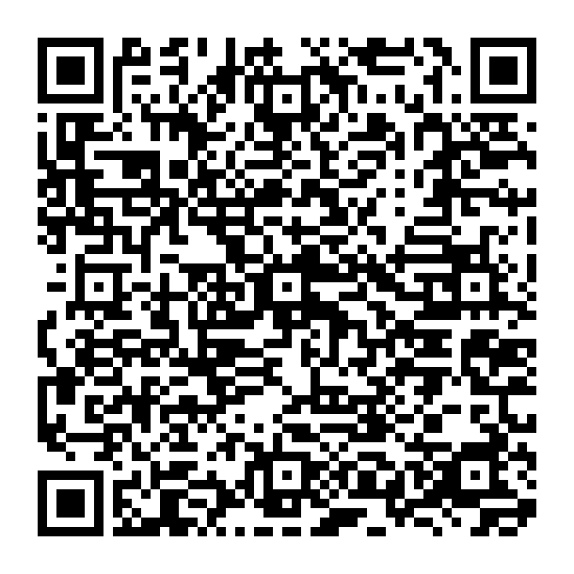


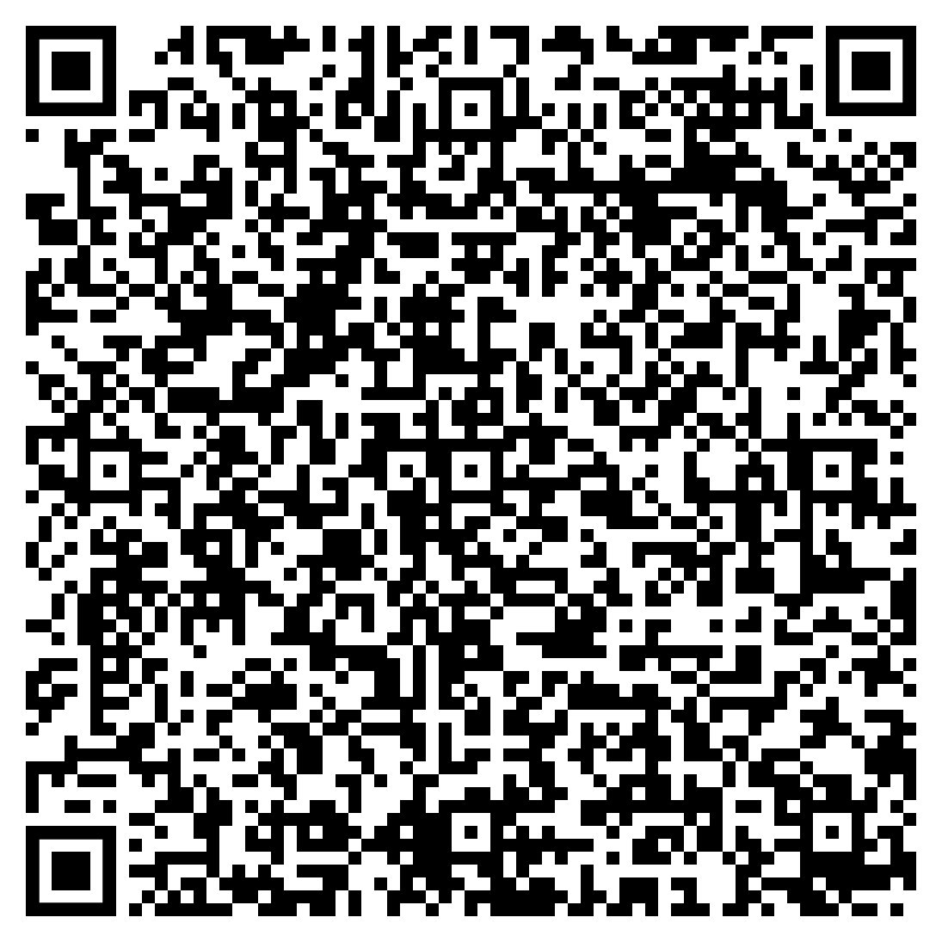
Welcome Slide
Introduction
Who were the victim(s)?:
Overview
What happen?:
Details
What is the impact of the incident?:
Summary
12-03-2025
1
All rights reserved
Notes:
https://www.straitstimes.com/singapore/over-3000-individuals-names-nric-numbers-leaked-due-to-ceas-it-system-error
Note: Actions taken by CEA
It has written to all affected individuals to inform them of the incident and its follow-up actions, and to apologise to them.
it immediately disabled the affected system function and launched a probe to identify the root cause.
“The IT system in which the issue occurred has since been secured, and recovery steps have been taken to contain it,” said CEA.
The agency added that it is reviewing its systems and processes with its vendor to prevent a recurrence.

